Slide 1
TGIH-VVCE
Team The Brocode
The Great India Hackathon
Anirudh Nitin Bakare
Kishore K
College: ATME College

Slide 2
Challenge
Build Robust AI+ML Services Effortlessly with Azure ML
Team
The Brocode

Slide 3
Topic
SIGN LANGUAGE INTERPRETER
Team
The Brocode

Slide 4
REASONS
63 MILLION PEOPLE
72 MILLION PEOPLE
THE BIGGEST PROBLEM
Indian Sign Language
68% FEEL ISOLATED
UNDEREMPLOYMENT
Of Deaf and Hard of Hearing community (DHH) in India who use sign language
Worldwide who use sign language
India has 18 equally significant languages
But ISL is not used in deaf schools to teach deaf children.
At Home, Work, Social Places
Don’t work or are underemployed
Team
The Brocode

Slide 5
PROJECT OUTLINE
STEP 1
STEP 3
STEP 2
STEP 4
Data Creation/Acquisition
Azure Cognitive Service
1
2
3
4
Data Preparation
Use Model
In Python
Team
The Brocode

Slide 6
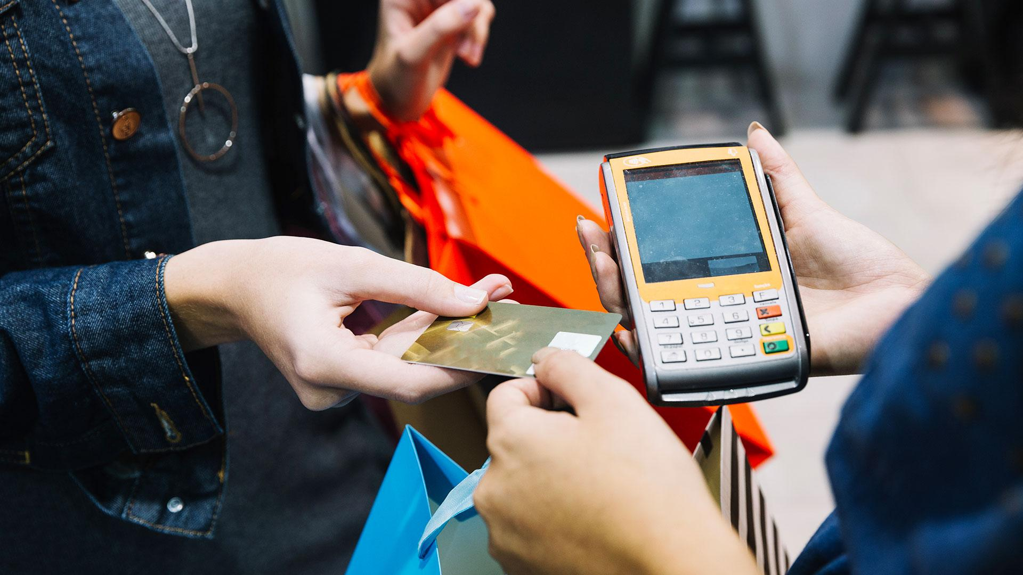
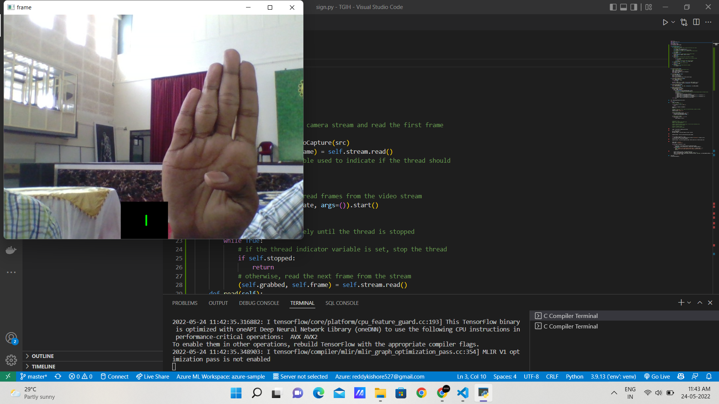
Snapshots

Slide 7
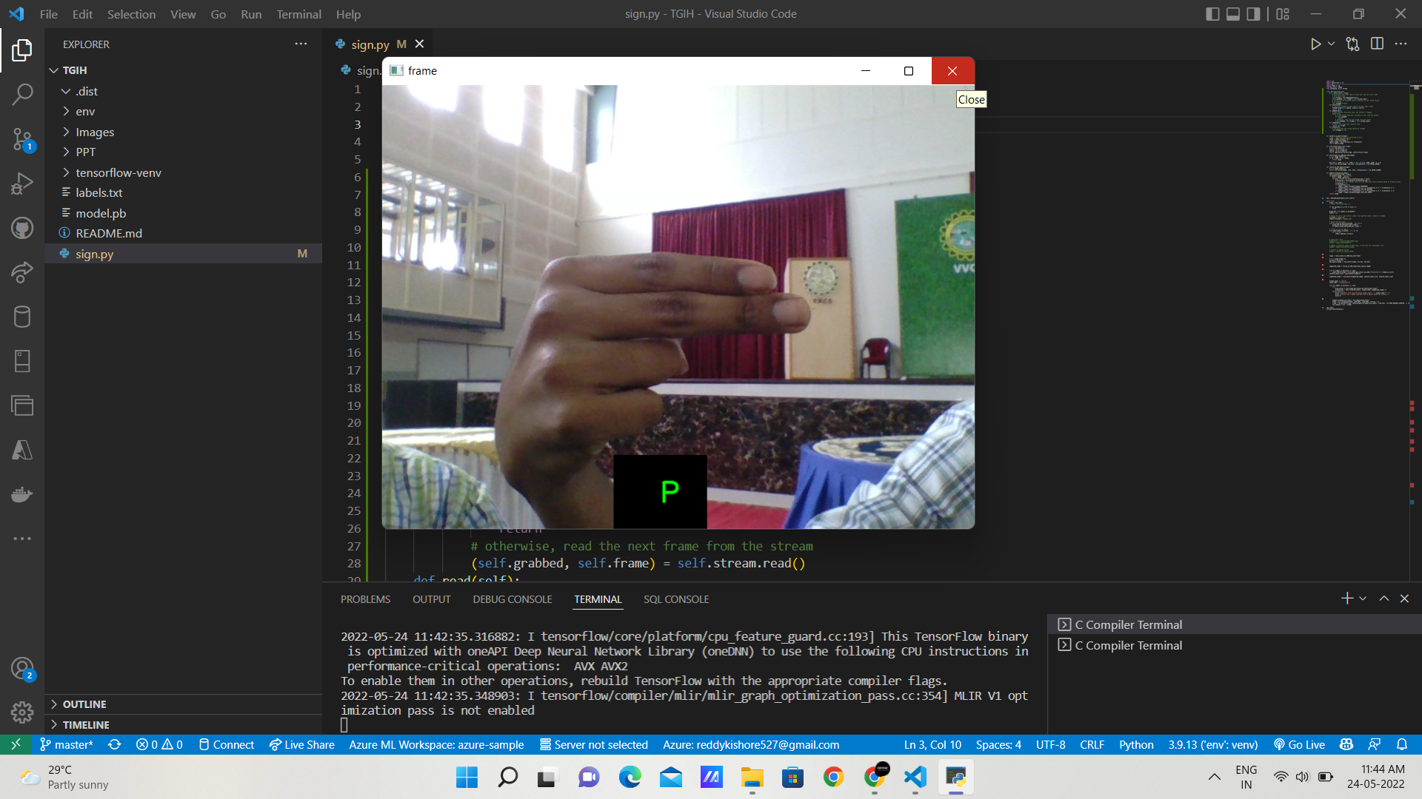
Snapshots

Slide 8
THANKS!
Do you have any questions?

